Slide 1
Module - III

Slide 2
Trees
A tree data structure is a hierarchical structure that is used to represent and organize data in a way that is easy to navigate and search.
It is a collection of nodes that are connected by edges and has a hierarchical relationship between the nodes.
A tree data structure is a hierarchical structure that is used to represent and organize data in a way that is easy to navigate and search.
It is a collection of nodes that are connected by edges and has a hierarchical relationship between the nodes.

Slide 3
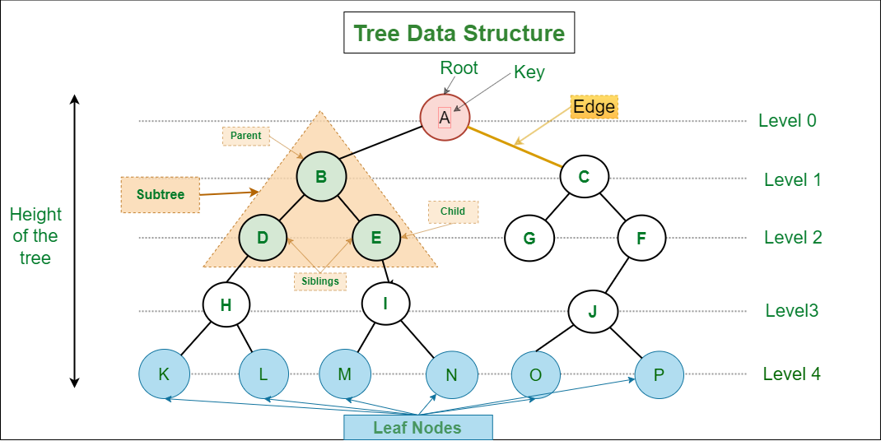
Trees

Slide 4
Basic Terminologies In Tree Data Structure
Parent Node
Child Node
Root Node
Leaf Node
Ancestor of a Node
Sibling
Subtree

Slide 5
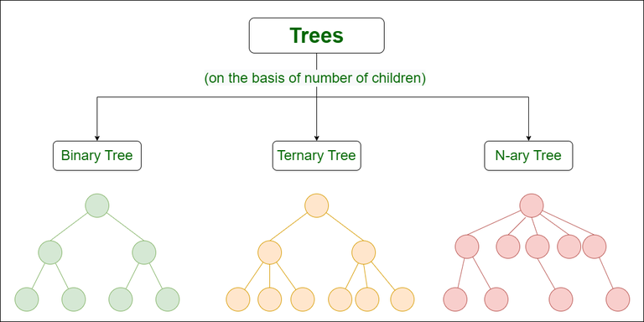
Types of Tree
Binary tree: In a binary tree, each node can have a maximum of two children linked to it.
Ternary Tree: A Ternary Tree is a tree data structure in which each node has at most three child nodes, “left”, “mid” and “right”.
N-ary Tree or Generic Tree: that consists of records and a list of references to its children.

Slide 6
Basic Operation Of Tree Data Structure
Create – create a tree in the data structure.
Insert − Inserts data in a tree.
Search − Searches specific data in a tree to check whether it is present or not.
Traversal:
Preorder Traversal – perform Traveling a tree in a pre-order manner in the data structure.
In order Traversal – perform Traveling a tree in an in-order manner.
Post-order Traversal –perform Traveling a tree in a post-order manner.

Slide 7
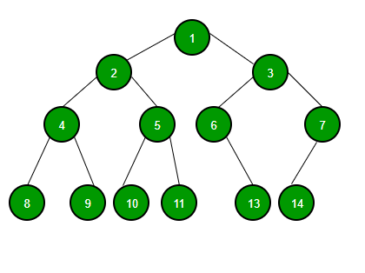
Binary Tree
Binary Tree is defined as a tree data structure where each node has at most 2 children. Since each element in a binary tree can have only 2 children, we typically name them the left and right child.

Slide 8
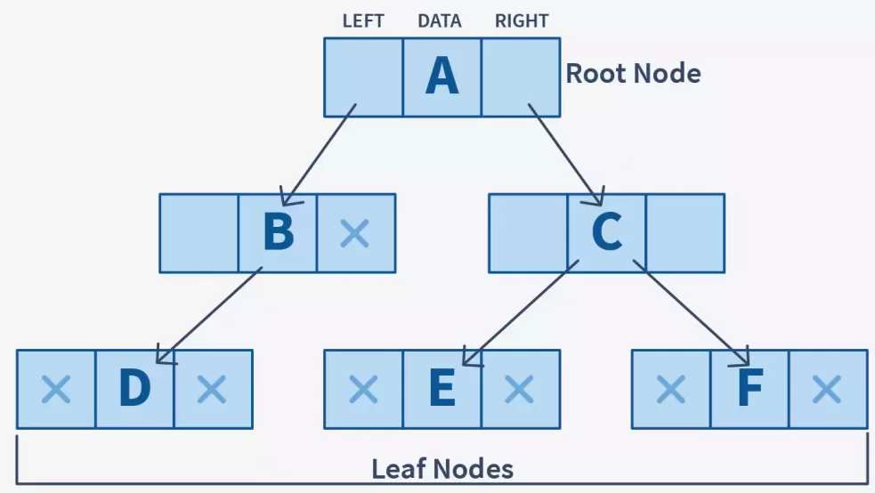
Binary Tree Representation
A Binary tree is represented by a pointer to the topmost node (commonly known as the “root”) of the tree. If the tree is empty, then the value of the root is NULL. Each node of a Binary Tree contains the following parts:
Data
Pointer to left child
Pointer to right child

Slide 9
Types of Binary Trees
Full Binary Tree
Complete Binary Tree
Perfect Binary Tree
Balanced Binary Tree
Degenerate Binary Tree

Slide 10
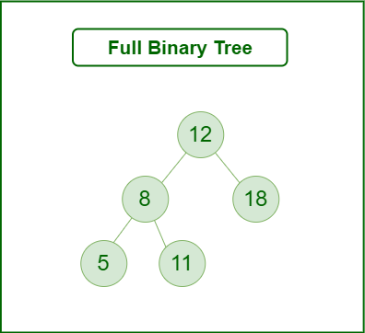
Full Binary Tree
A full binary tree is a tree structure. A binary tree node can have either two children or no child.

Slide 11
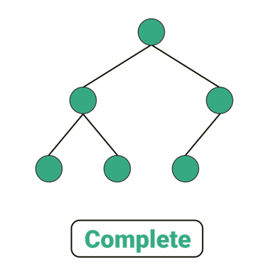
Complete Binary Tree
A complete binary tree is another specific binary tree where each node on all levels except the last level has two children. And at the lowest level, all leaves should reside possibly on the left side.

Slide 12
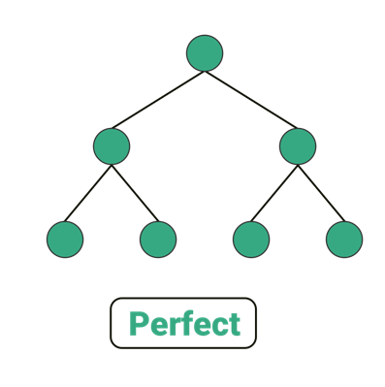
Perfect Binary Tree
A binary tree is said to be perfect if every node must have two children and every leaf is present on the same level.

Slide 13
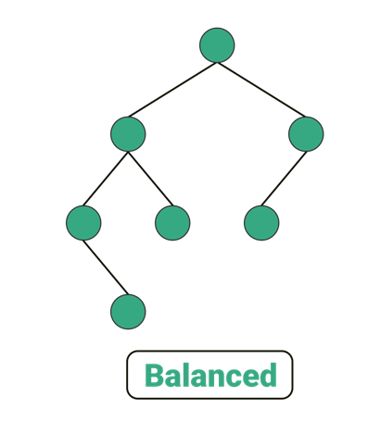
Balanced Binary Tree
It balances a binary tree for each node if its balance factor is either -1,0 or 1. The height of the left subtree and that of the right tree can vary by at most one.
Balance factor = height(left subtree) - height(right subtree)

Slide 14
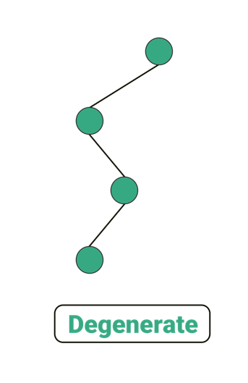
Degenerate Binary Tree
A binary tree is referred to as a degenerate binary tree only if every internal node has exactly one child.

Slide 15
Binary Search Trees
Binary Search Tree is a node-based binary tree data structure which has the following properties
The left subtree of a node contains only nodes with keys lesser than the node’s key.
The right subtree of a node contains only nodes with keys greater than the node’s key.
The left and right subtree each must also be a binary search tree.

Slide 17
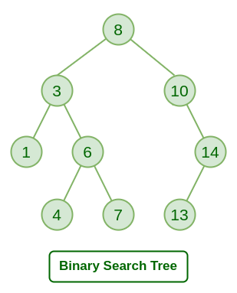
Binary Search Trees
Insert
Delete
Search
Traverse

Slide 18
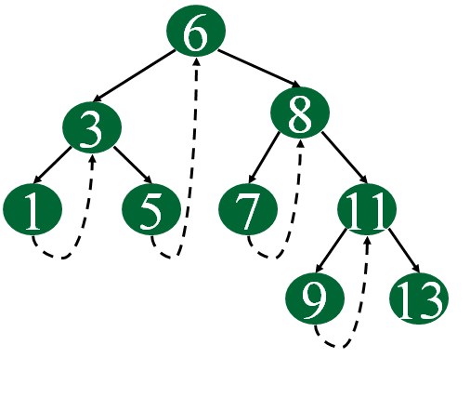
Threaded Binary Trees
A threaded binary tree is a type of binary tree data structure where the empty left and right child pointers in a binary tree are replaced with threads.
That link nodes directly to their in-order predecessor or successor.
It providing a way to traverse the tree without using recursion or a stack.

Slide 19
Threaded Binary Trees
Single Threaded: Where a NULL right pointers is made to point to the inorder successor (if successor exists)
Double Threaded: Where both left and right NULL pointers are made to point to inorder predecessor and inorder successor respectively. The predecessor threads are useful for reverse inorder traversal and postorder traversal.
The threads are also useful for fast accessing ancestors of a node.

Slide 20
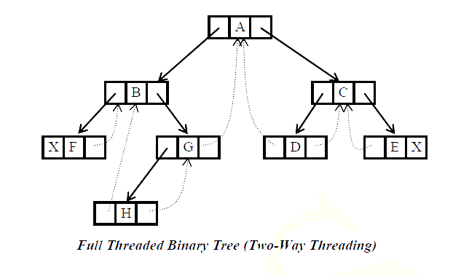
Threaded Binary Trees

Slide 21
Height Balanced Trees
To check if the binary tree is height-balanced or not, have to check the height balance of each node.
For this, need to calculate the heights of the two subtrees for each node making this impractical.
Instead, user can store the height balance information of every subtree in the root node of that subtree.
Thus, each node not only maintains its data and children’s information but also a height balance value.

Slide 22
Height Balanced Trees
The above formula means that:
If the right subtree is taller, the height balance of the node will be Negative.
If the left subtree is taller, the balance of the node will be Positive.
Conditions
The difference between the heights of the left and the right subtree for any node is not more than one.
The left subtree is balanced.
The right subtree is balanced

Slide 23
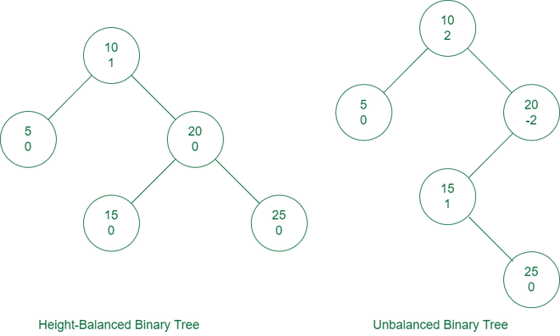
Height Balanced Trees

Slide 24
Heap
A heap is a complete binary tree, and the binary tree is a tree in which the node can have utmost two children.
Operations
Heapify: a process of creating a heap from an array.
Insertion: process to insert an element in existing heap time complexity O(log N).
Deletion: deleting the top element of the heap or the highest priority element, and then organizing the heap and returning the element with time complexity O(log N).
Peek: to check or find the first (or can say the top) element of the heap.

Slide 25
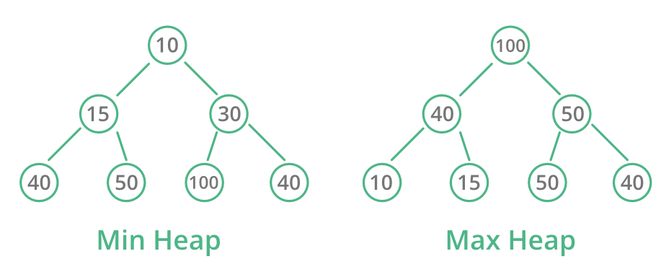
Heap Types
Max-Heap: In a Max-Heap the key present at the root node must be greatest among the keys present at all of it’s children. The same property must be recursively true for all sub-trees in that Binary Tree.
Min-Heap: In a Min-Heap the key present at the root node must be minimum among the keys present at all of it’s children. The same property must be recursively true for all sub-trees in that Binary Tree.

Slide 26
Heap
Heep Tree for this
44, 33, 77, 11, 55, 88, 66
88
77
55
11
33
44

Slide 27
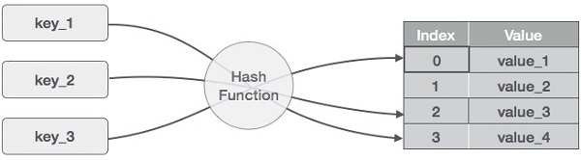
Hash table
Hash Table is a data structure which stores data in an associative manner. In a hash table, data is stored in an array format.
Each data value has its own unique index value.
Access of data becomes very fast if user know the index of the desired data.
Static Hash
Dynamic Hash

Slide 28
Hash table
Example
0 | 1 | 2 | 3 | 4 | 5 | 6 | 7 | 8 | 9 | 10
54, 26,93,17,77, 31
77 |  |  |  | 26 | 93 | 17 |  |  | 31 | 54
0 | 1 | 2 | 3 | 4 | 5 | 6 | 7 | 8 | 9 | 10

Slide 29
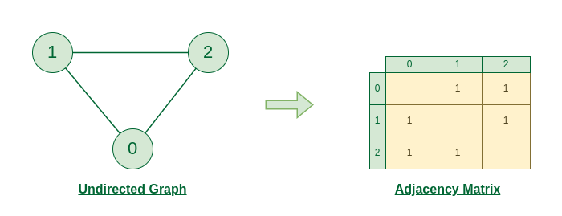
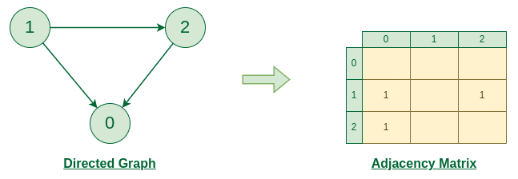
Graph and its representations
Adjacency Matrix
An adjacency matrix is a way of representing a graph as a matrix of boolean (0’s and 1’s).
Let’s assume there are n vertices in the graph So, create a 2D matrix adjMat[n][n] having dimension n x n.
Figure: Undirected Graph
Figure: Directed Graph

Slide 30
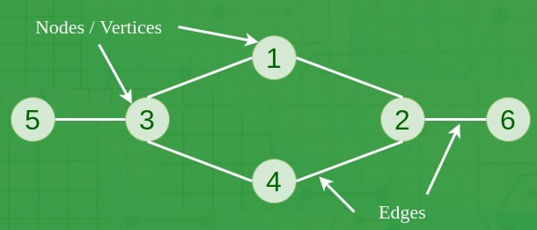
Graph
A Graph is a non-linear data structure consisting of vertices and edges.
The vertices are sometimes also referred to as nodes and the edges are lines or arcs that connect any two nodes in the graph.
More formally a Graph is composed of a set of vertices( V ) and a set of edges( E ). The graph is denoted by G(E, V).

Slide 31
Graph Traversal
Graph traversal (also known as graph search) refers to the process of visiting (checking and/or updating) each vertex in a graph.
Such traversals are classified by the order in which the vertices are visited.
Types:
Breadth First Search (BFS)
Depth First Search (DFS)

Slide 32
Breadth First Search (BFS)
The Breadth First Search (BFS) algorithm is used to search a graph data structure for a node that meets a set of criteria.
It starts at the root of the graph and visits all nodes at the current depth level before moving on to the nodes at the next depth level.
BFS : 8,3,10,1,6,14,4,7,13

Slide 33
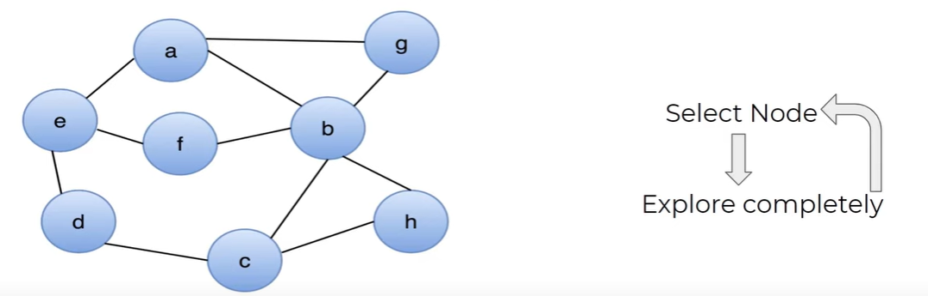
Breadth First Search (BFS)
One of the possible BFS : a e b g f d c h

Slide 34
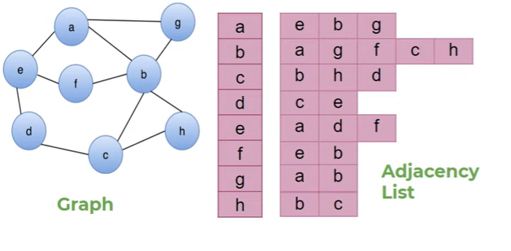
Breadth First Search (BFS)
Queue
Processing Node
e | b | g
a
Visited
a | e | b | g | f | d | c | h

Slide 35
Applications of (BFS)
Shortest Path for unweighted graph
Minimum Spanning Tree for weighted graphs
Minimum Spanning Tree for weighted graphs
Peer-to-Peer Networks (BitTorrent)
Social Networking Websites (people within a given distance)
GPS Navigation systems

Slide 36
Depth First Search (DFS)
One of the possible DFS : a e d c b h g f

Slide 37
Depth First Search (DFS)
Depth-first search is an algorithm for traversing or searching tree or graph data structures.
The algorithm starts at the root node (selecting some arbitrary node as the root node in the case of a graph) and explores as far as possible along each branch before backtracking.
DFS : 8,3,1,6,4,7,10,14,13

Slide 38
Depth First Search (DFS)
Stack
Dfs(e)
Dfs (a)
Visiting Array
a | b | c | d | e | f | g | h
T | F | F | F | T | F | F | F
Visited

Slide 39
Applications of (BFS)
Detecting cycle in a graph
Path Finding
Topological Sorting
Solving puzzles with only one solution
Web crawlers
Backtracking

Slide 40
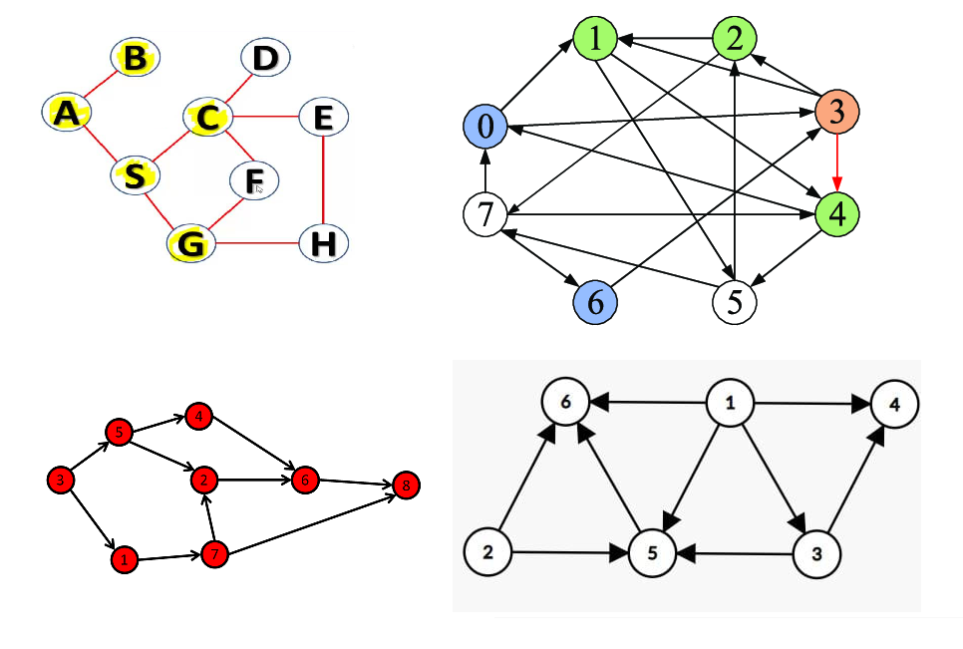
Samples

Slide 41
Disjoint Sets
Set = a collection of (distinguishable) elements
Two sets are disjoint if they have no common elements
Disjoint-set data structure:
maintains a collection of disjoint sets
each set has a representative element
supported operations:
Find(x)
Union(x,y)

Slide 42
Find operation
It is easier to check, given 2 elements, where they belong to the same subset.
S1 S2
is S(1) == S(2).?
1,2,3,4
5,6,7

Slide 43
Union operation
Used to merge two sets into single set ( S1 U S2 )
1,2,3,4
5,6,7
1,2,3,4,5,6,7

Slide 44
Disjoint Sets
Data structure using chaining to define a set. the chain is defined by a parent child relationship.
1,2,3
1
2
1
2
3
2
3
3
1
Node
Parent
1 | 2 | 3
-1 | 1 | 2
Node
Parent
1 | 2 | 3
-1 | 1 | 1
Node
Parent
1 | 2 | 3
3 | -1 | 2

Slide 45
Sets Representation
1,2,3
4,5,6
1
6
2
5
3
4
Node
Parent
1 | 2 | 3 | 4 | 5 | 6
-1 | 1 | 2 | 5 | 6 | -1
Find: Are (2,5) in the same set.?
Merge: 2 sets into 1

Slide 46
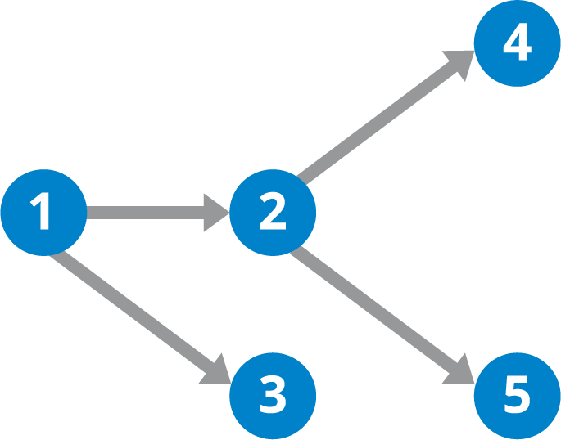
Directed Acyclic graph (DAG)
A directed acyclic graph (DAG) is a conceptual representation of a series of activities.
The order of the activities is depicted by a graph, which is visually presented as a set of circles, each one representing an activity, some of which are connected by lines, which represent the flow from one activity to another.
Directed Acyclic Graph (DAG) Diagram

Slide 47
Longest Path in DAG
Input Output
2
2
5
3
4
5
3
4
1
5
3
4
1

Slide 48
Topological Sort
Topological sorting for Directed Acyclic Graph (DAG) is a linear ordering of vertices such that for every directed edge uv, vertex u comes before v in the ordering.
Topological Sorting for a graph is not possible if the graph is not a DAG
V1
V2
V3
V4
V5
V6
V7

Slide 49
Topological Sort
V1
V2
V3
V4
V5
V6
V7
 | v1 | v2 | v3 | v4 | v5 | v6 | v7
V1 | 0 | 1 | 1 | 1 | 0 | 0 | 0
V2 | 0 | 0 | 0 | 1 | 1 | 0 | 0
V3 | 0 | 0 | 0 | 0 | 0 | 1 | 0
V4 | 0 | 0 | 1 | 0 | 0 | 1 | 1
V5 | 0 | 0 | 0 | 1 | 0 | 0 | 1
V6 | 0 | 0 | 0 | 0 | 0 | 0 | 0
v7 | 0 | 0 | 0 | 0 | 0 | 1 | 0

Slide 50
Topological Sort
In degree of V
 |  | P1 | p2
V1 | 0
V2 | 1
V3 | 2
V4 | 3
V5 | 1
V6 | 3
v7 | 2
Sort Order : V1, V2, V5, V4, V3, V7, V6

